Slide 1

ENVIRONMENT IMPACT ASSESMENT
PROF. KAMLESH PARIHAR
ASSOCIATE PROF.
CIVIL ENGINEERING DEPARTMENT
JIET JODHPUR

Slide 2
Eis (Environment Impact Statement)
An Environmental Impact Statement (EIS) is a document prepared to describe the effects for proposed activities on the environment. Here, "Environment,", is defined as the natural and physical environment and the relationship of people with that environment. This means that the "environment" considered in an EIS includes land, water, air, structures, living organisms, environmental values at the site, and the social, cultural, and economic aspects. An "impact" is a change in consequence that results from an activity. Impacts can be positive or negative or both. An EIS describes impacts, as well as ways to "mitigate" impacts. To "mitigate" means to lessen or remove negative impacts. Public Consultation is an important in EIS. It will be discussed in detail in unit 3.

Slide 3
EMP (Environmental Management Plan)
Environmental Management is the process of allocating natural and artificial resources so as to make optimum use of the environment in satisfying basic human needs at the minimum, and more if possible, on a sustainable basis.
It can also be defined as a generic description of a process undertaken by systems-oriented professionals with a natural science, social science, or less commonly an engineering, law, or design background, tackling problems of the human altered environment on a interdisciplinary basis from an quantitively and or futuristic viewpoint.
A well formed and documented action plan which describes above activities is called as environmental management plan.

Slide 4
Projects which need eia
ACCORDING TO EIA NOTIFICATION 2006, GOVERNMENT OF INDIA
Mining
River valley project (Construction of Dam, Hydroelectric Power Project)
Off shore and On Shore Oil Exploration
Thermal Power Plants
Nuclear Power Plants
Coal Washeries
Cement Plant
Chemical Refinery / Chemical Manufacturing Factory
Industries of Leather/Skin/Synthetic Materials, Chemical and Dye, Paper & Pulp, Hazardous Materials etc. having any effect on environment.

Slide 5
Characteristics of EMP
It is often used as a generic term. It supports sustainable development. It deals with a world affected by human beings. It demands a multidisciplinary or interdisciplinary approach. It has to integrate different development viewpoints. It seeks to integrate science, social science, policy-making and planning. It recognizes the desirability of meeting, and if possible exceeding basic human needs. The time-scale involved extends beyond the short-term and concerns range from local to global. It should show opportunities as well as address threats and problems.
It stresses stewardship, rather than exploitation.

Slide 6
Types of environmental impacts ^{[1]}
Beneficial or detrimental
Naturally reversible or irreversible
Repairable via management practices or irreparable
Short term or long term
Temporary or continuous
Occurring during construction phase or operational phase
Local, regional, national, or global
Accidental or planned (recognized before hand)
Direct (primary) or indirect (secondary)
Cumulative or single

Slide 7
Steps in eia ^{[1]}
Project screening: Not all development projects require EIA. Project screening will help to identify the ones that actually do. This section describes the various screening criteria. This is done by CPCB
Scoping: The process of scoping helps determine the coverage or “scope” of the EIA. The methods of scoping are elaborated in this section.
Baseline data collection: A brief explanation on the concept of baseline data collection, its purposes, source of collection of baseline data, and derivation of primary data are given in this part of EIA process.
Identification of environmental impacts: Described here are the various types of environmental impacts of development projects both beneficial and adverse.

Slide 8
Steps in eia (contd..)
Impact prediction comparison of alternatives and determination of significance: This section covers the considerations for impact prediction, uncertainties in impact prediction, and comparison of alternatives for impact prediction.
Mitigation measures: Described briefly under this section are the concept and objectives, types, and interesting points of mitigation measures.
Public consultation and participation: Public participation is a necessary component of the EIA. “Who are the public?”, “How to involve them?”, and “What are the benefits/ disbenefits?” The answers can be found under this section. This mainly constitutes the report on the socioeconomic environment.

Slide 9
Steps in eia (contd..)
Environmental monitoring: As one of the most important aspects of EIA, “environmental monitoring” is defined here along with explanations on monitoring principles, types, and institutional aspects.
Environmental auditing: You will find under this section the various types of environmental auditing and when it should be carried out during the EIA

Slide 10
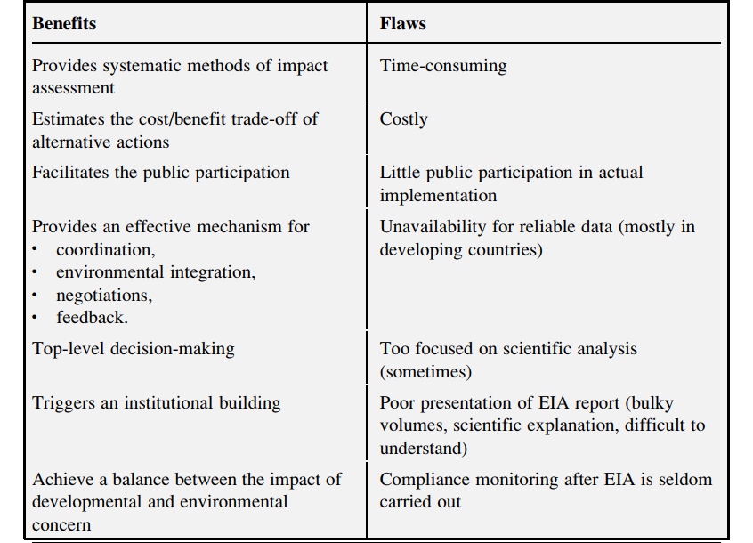
Eia benefits and flaws

Slide 11
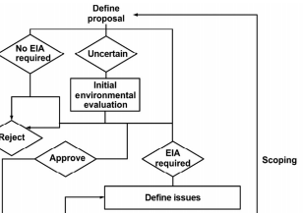
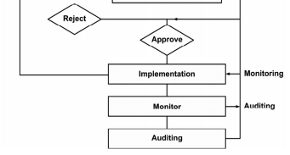
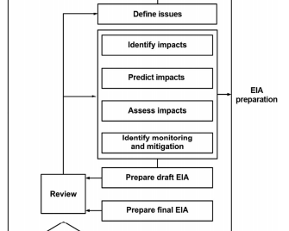

Slide 12
screening
There are Four Broad Steps in EIA
Screening
Scoping
Public Consultation
Appraisal

Slide 13
Methods of EIA
There are seven general methods of EIA
Ad hoc
Checklists
Matrices
Networks
Overlays
Cost/benefit analysis
Modeling

Slide 14
Checklists Method
Environmental factors are listed in a structured format and weightage is given to each factor based on the impacts it has on environment.
This method is done to assess the nature of impacts i.e. adverse or beneficial. The adverse/beneficial impacts are further sub categorized into short term-long term, no impact-significant impact or reversible – irreversible impact etc.
It is extensive and complete. All possible impacts are listed in the checklist.
Scaling matrix is generally used in final evaluation of a project and in comparing the different alternatives.

Slide 15
Checklists Method
It should identify the impacts on
SOIL
WATER
ATMOSPHERE
FLORA
FAUNA
Resources
Recreation
Cultural

Slide 16
Checklists are mainly of 4 types
Simple: No information on magnitude or importance of impacts
Descriptive: Require information on magnitude or importance of impacts as well as indication on prediction methods and indicators.
Scaling & Rating:- Against each impact, a scale of 1-3 is used to quantitatively estimate the impact

Slide 17
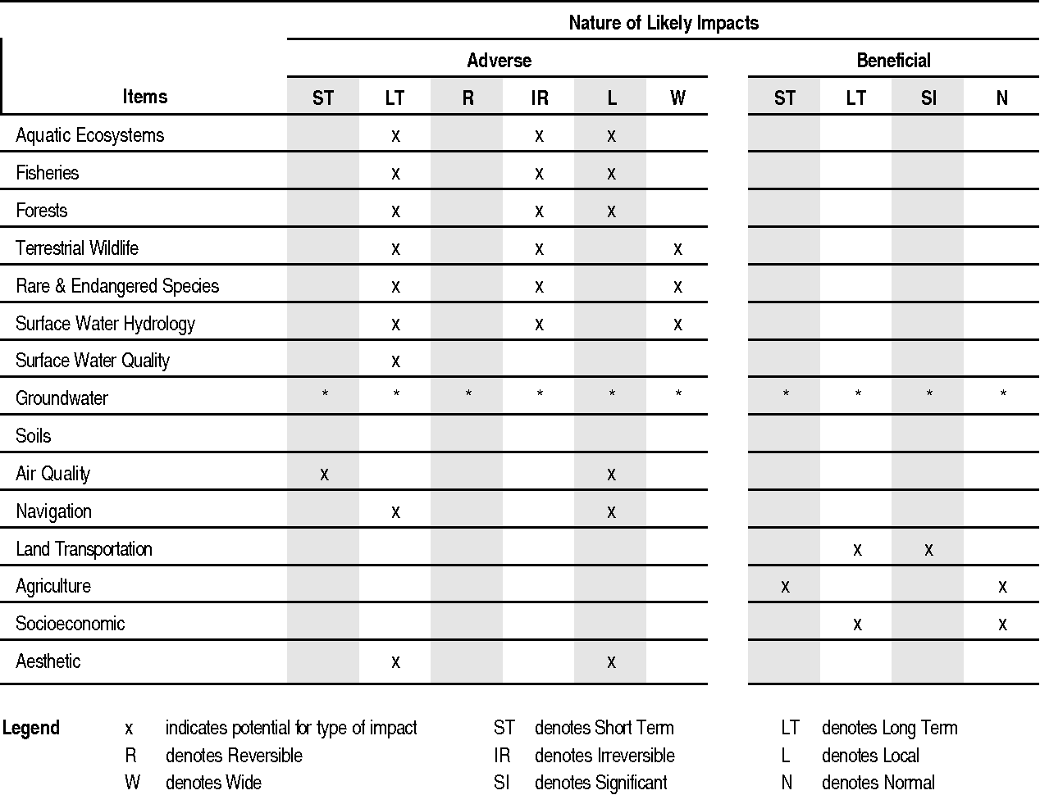
Simple Checklists Method

Slide 18
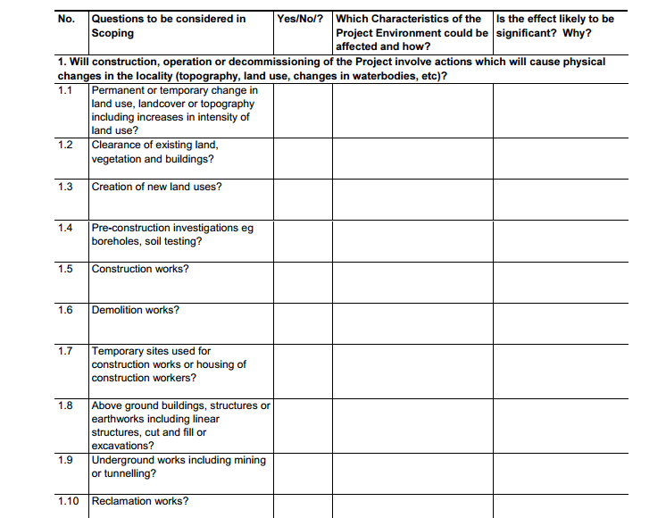
Descriptive Checklists Method

Slide 19
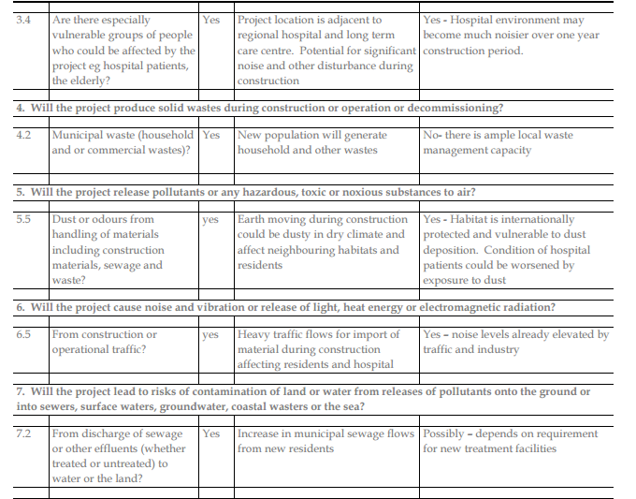
Example of Descriptive Checklist Method (Source from internet)

Slide 20
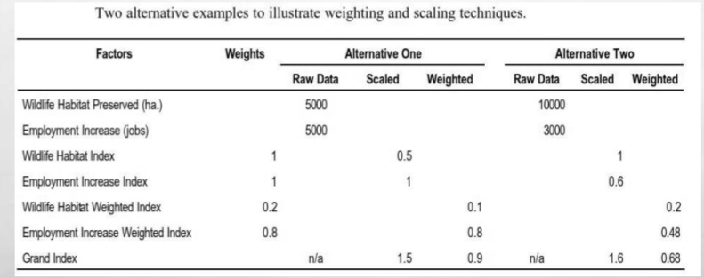
Scaling and Weighing Checklist

Slide 21
Matrix Method
Matrix is a presentation of information in grid form.
In this method project activities (e.g. construction, demolition, querrying etc.) are mentioned on one axis while environmental factors (e.g. air, water, land, flora, fauna, forests, aquatic life, rivers, farming etc.) are mentioned on other axis. If impact due to any activity on environmental factor exists it is mentioned in corresponding cell.
If more information is required about a project, then symbols, color coding or ranking (1,2,3..) can be used to mention the intensity and importance of the impact.
Earliest example of a matrix method is Leopold Interaction Matrix. It is an comprehensive matrix having 88 environmental factors/characteristics and 100 project activities. Generally in all project we need to take only those activities and environmental factors which are actually affected.

Slide 22
Matrix Method
This example is of eia of maa waste WATER TREATMENT PLANT AT NACHARAM AND MALLAPUR INDUSTRIAL AREA DEVELOPED JOINTLY BY INDWA GROUP, GOVERNMET OF INDIA AND GOVERNMENT OF Andhra Pradesh

Slide 23
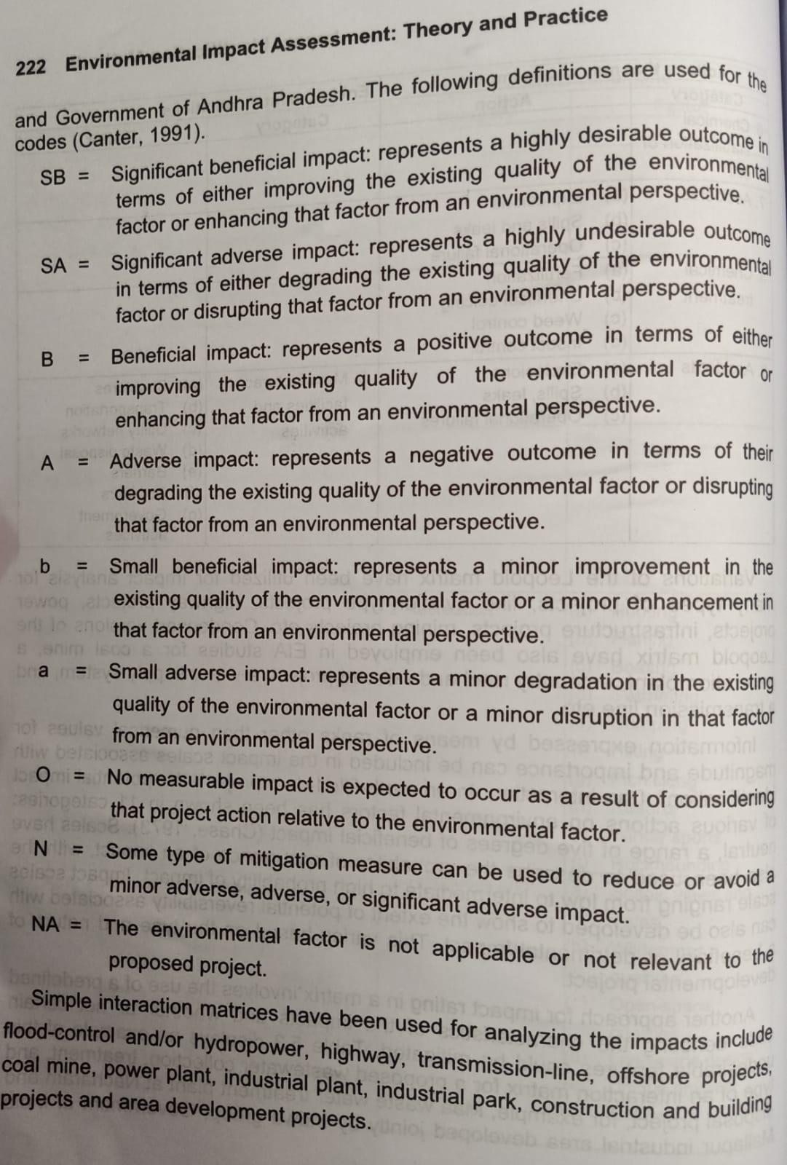

Matrix Method

Slide 24
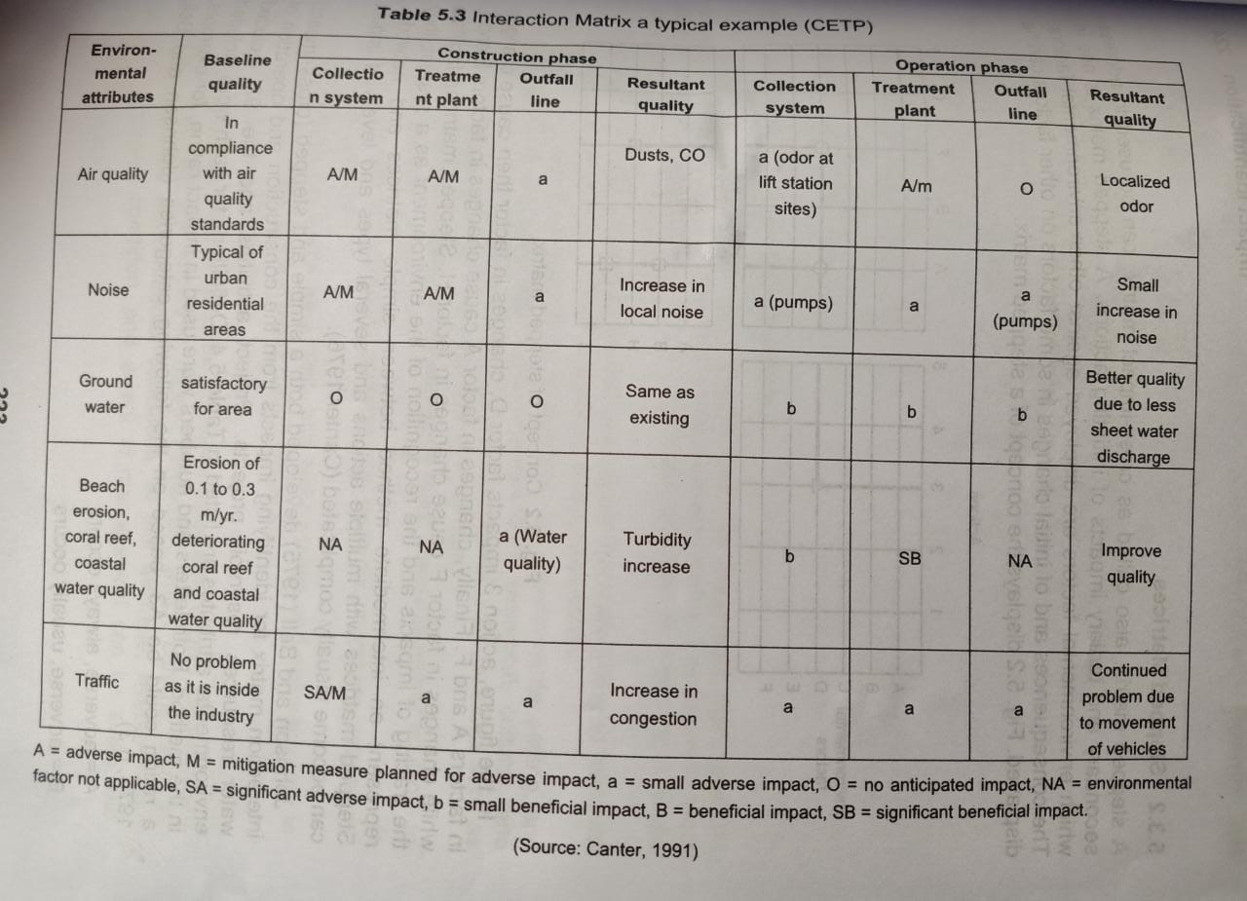
Matrix Method

Slide 25
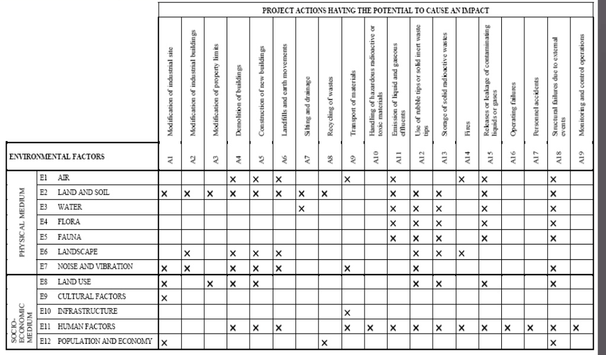
Matrix Method

Slide 26
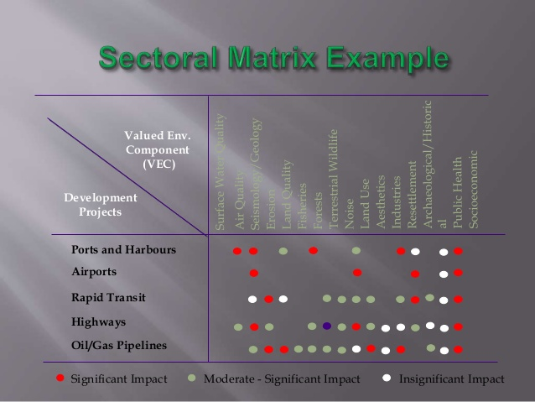
Matrix Method

Slide 27
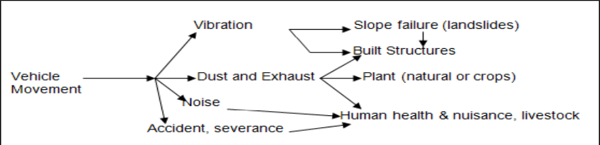
Network Method
In this method the relationship between the project activities and their effects are shown.
Secondary effects can also be seen easily.
It does not provide any information about the magnitude and importance of impact.
It is generally shown as flow diagram.

Slide 28
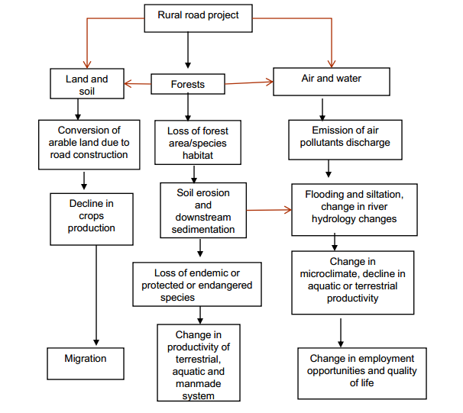
Network Method Example

Slide 29
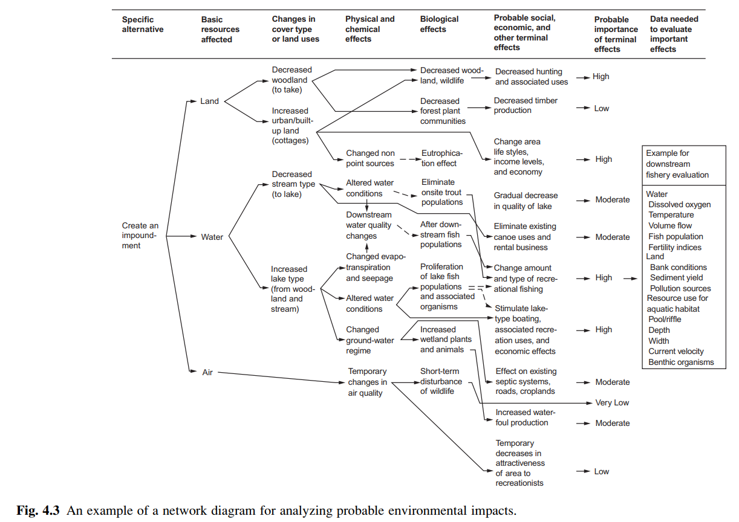
Network Method Example

Slide 30
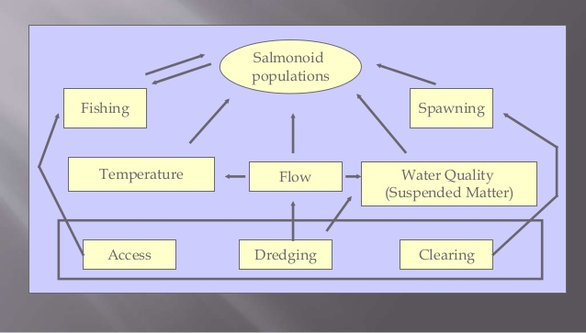
Network Method Example

